Slide 1
Exercise 10: Topic models
Cognition & Communication, Instructor: Adam Finnemann

Slide 2
Today’s program

Slide 3
Preprocessing steps in STM
STM package comes with preprocessing function:
You made the step yourselves last time
I provdided a function
STM’s steps:
Converting to Lower Case...
Removing punctuation...
Removing stopwords...
Removing numbers...
Stemming...

Slide 4
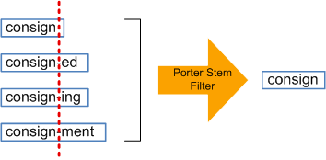
Stemming
The process of reducing a derived form of a word to it’s stem.
Range of alogrithms:
From ”S” removal to hundres of rules (Moral et al. 2014)
No perfect methods – natural langue is too complex

Slide 5
Threat related information
Boyer’s idea: Types of information influence social cognition.
Threat-information influences social cognition positively: sources are viewed as more compentent.
Seems evolutionarily/culturally plausible.
A potential explanation for conspiracies, rumours, religions, populism etc.

Slide 6
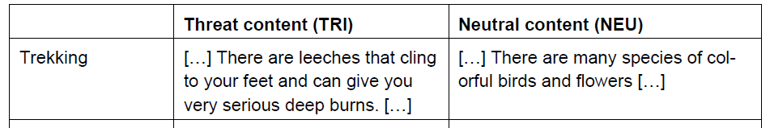
Pascal’s experiment
People presented with threat content judged the source as more competent
Counfounding factors:
practicality bias: useful vs useless information
Contrast effect

Slide 7
Our desgin
Same information in both conditions.
Different framings
Person relative threat informations
Hypotheses:
H1: Threat conditions are judged to belong to more competent newspapers (W.A. & Politiken)

Slide 8
Discussion
What are your thoughts on the experiment?
What factors influenced your decisions?
What problems do you see in our study?
Our worries:
the effect of threat on competence judgemens might not hold in a news context
Framing might not be enough to activate threat processesing system

Slide 9
Today’s main focus
Finding predictors of reading speed (covariates) for your reading experiments.
What factors do you think could play a role?
Word information and psycholinguistic variables can be found at UWC’s database
We will extract variables for your word lists and see if they correlate with reading speed.

Slide 10
On data and theory
”Data without a theory is like a baby without a parent. Life expectency is very low” (Gigerenzer, 1988)
Published in Journal, Theory and Psychology

Slide 12
Procedure:
1) Extract list of words from R
2) Put list into UWC database and get variables (frequency, concreteness, AOA)
3) import variables into R
4) Perform correlation analysis

Slide 13
Reference
Moral, C., de Antonio, A., Imbert, R. & Ramírez, J. (2014). A survey of stemming algorithms in information retrieval/ Information Research, 19(1) paper 605. [Available at http://InformationR.net/ir/19-1/paper605.html]
Gigerenzer, G., Surrogaes for Theories, Theory & Psychology, 8(2),

